Slide 1
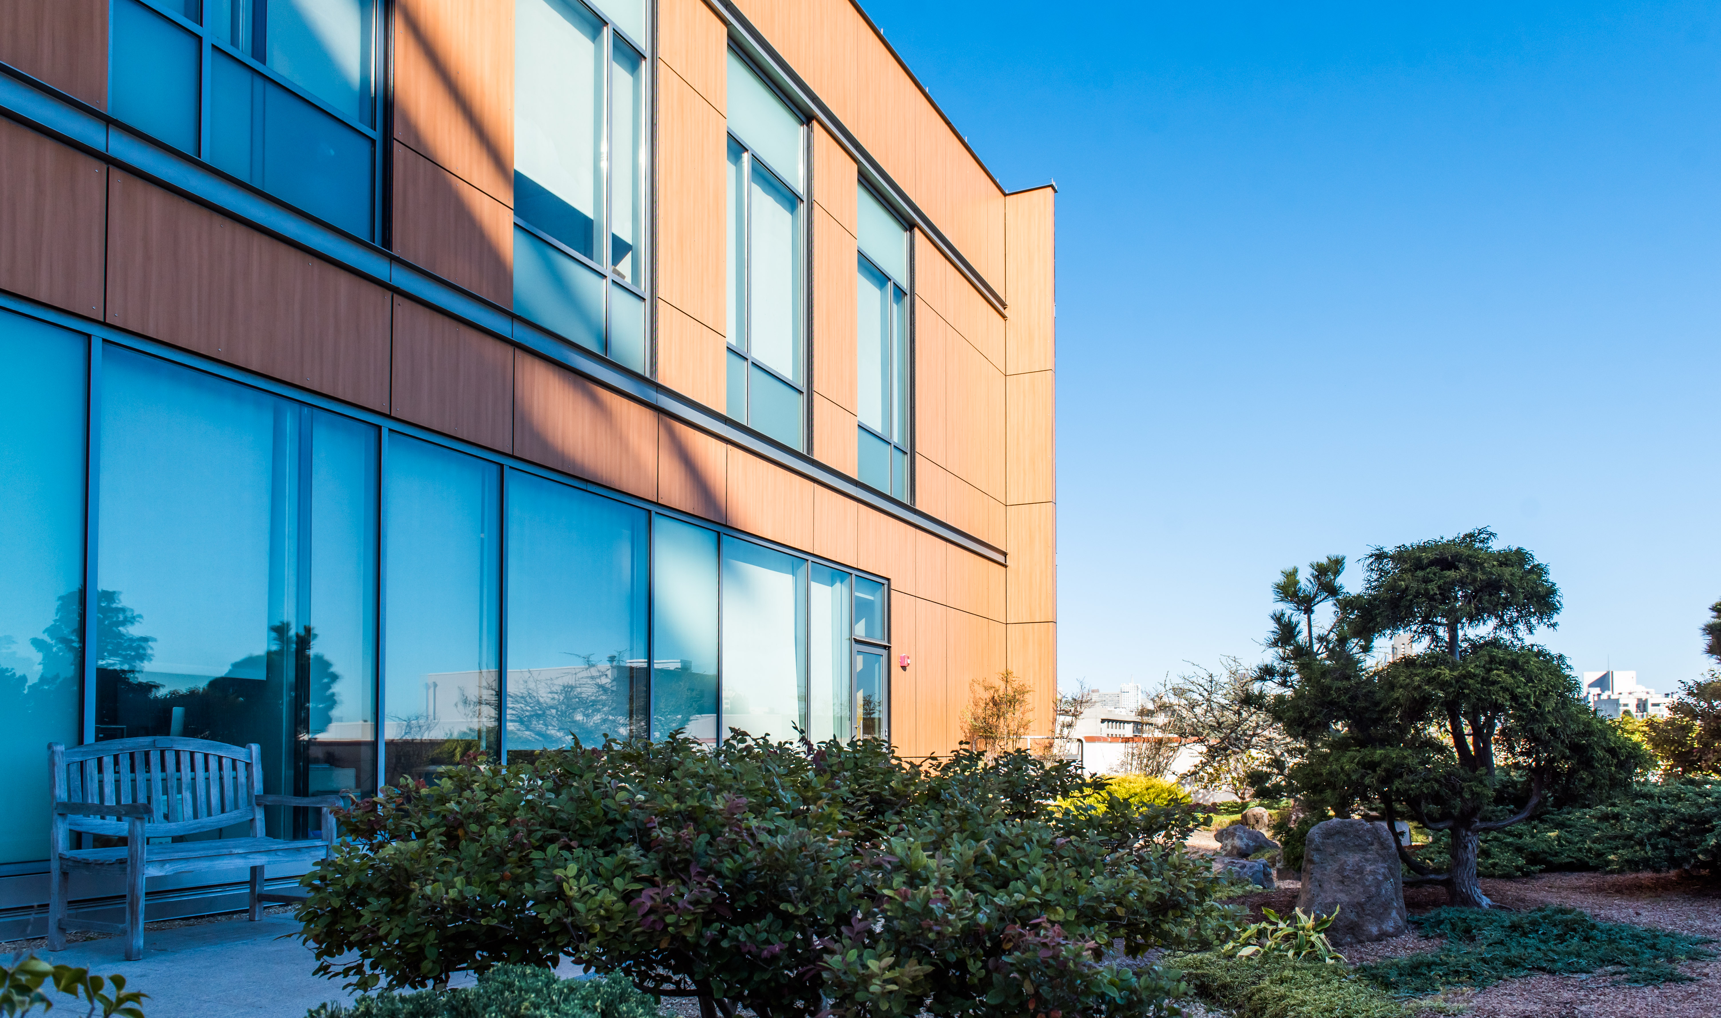

Operational Science & Financial Models for Group Medical Visits
Implementing Practical and Sustainable Delivery Paradigms in Integrative Health
Kavita K. Mishra, MD, MPH UCSF Osher
Gabriela Gutierrez, BS UCSF Osher
Greta Kuphal, MD U Wisconsin Osher
Gurjeet Birdee, MD, MPH Vanderbilt Osher
Katy Hansen, PhD Vanderbilt Osher

Slide 2
Outline
Introduction to Osher Centers for Integrative Health (OCIH) and Group Medical Visits (GMVs) – 5 min
Overview of operational, financial, and implementation learnings
  OCIH San Francisco – 10 min
  OCIH Madison-Wisconsin – 10 min
  OCIH Vanderbilt – 10 min
Q&A – 25 min

Slide 3
Osher Centers for Integrative Health & Group Medical Visits

Slide 4











Overview of The Collaborative: Research, Education, and Clinics
1998
2022
2001
2022
2005
2021
2014
2021
2014
2018
2017
Notes:
Network of 11 centers in the US and across the world
Founded and funded by Bernard Osher, American businessman and philanthropist
The centers house research, education, and clinical teams

Slide 5
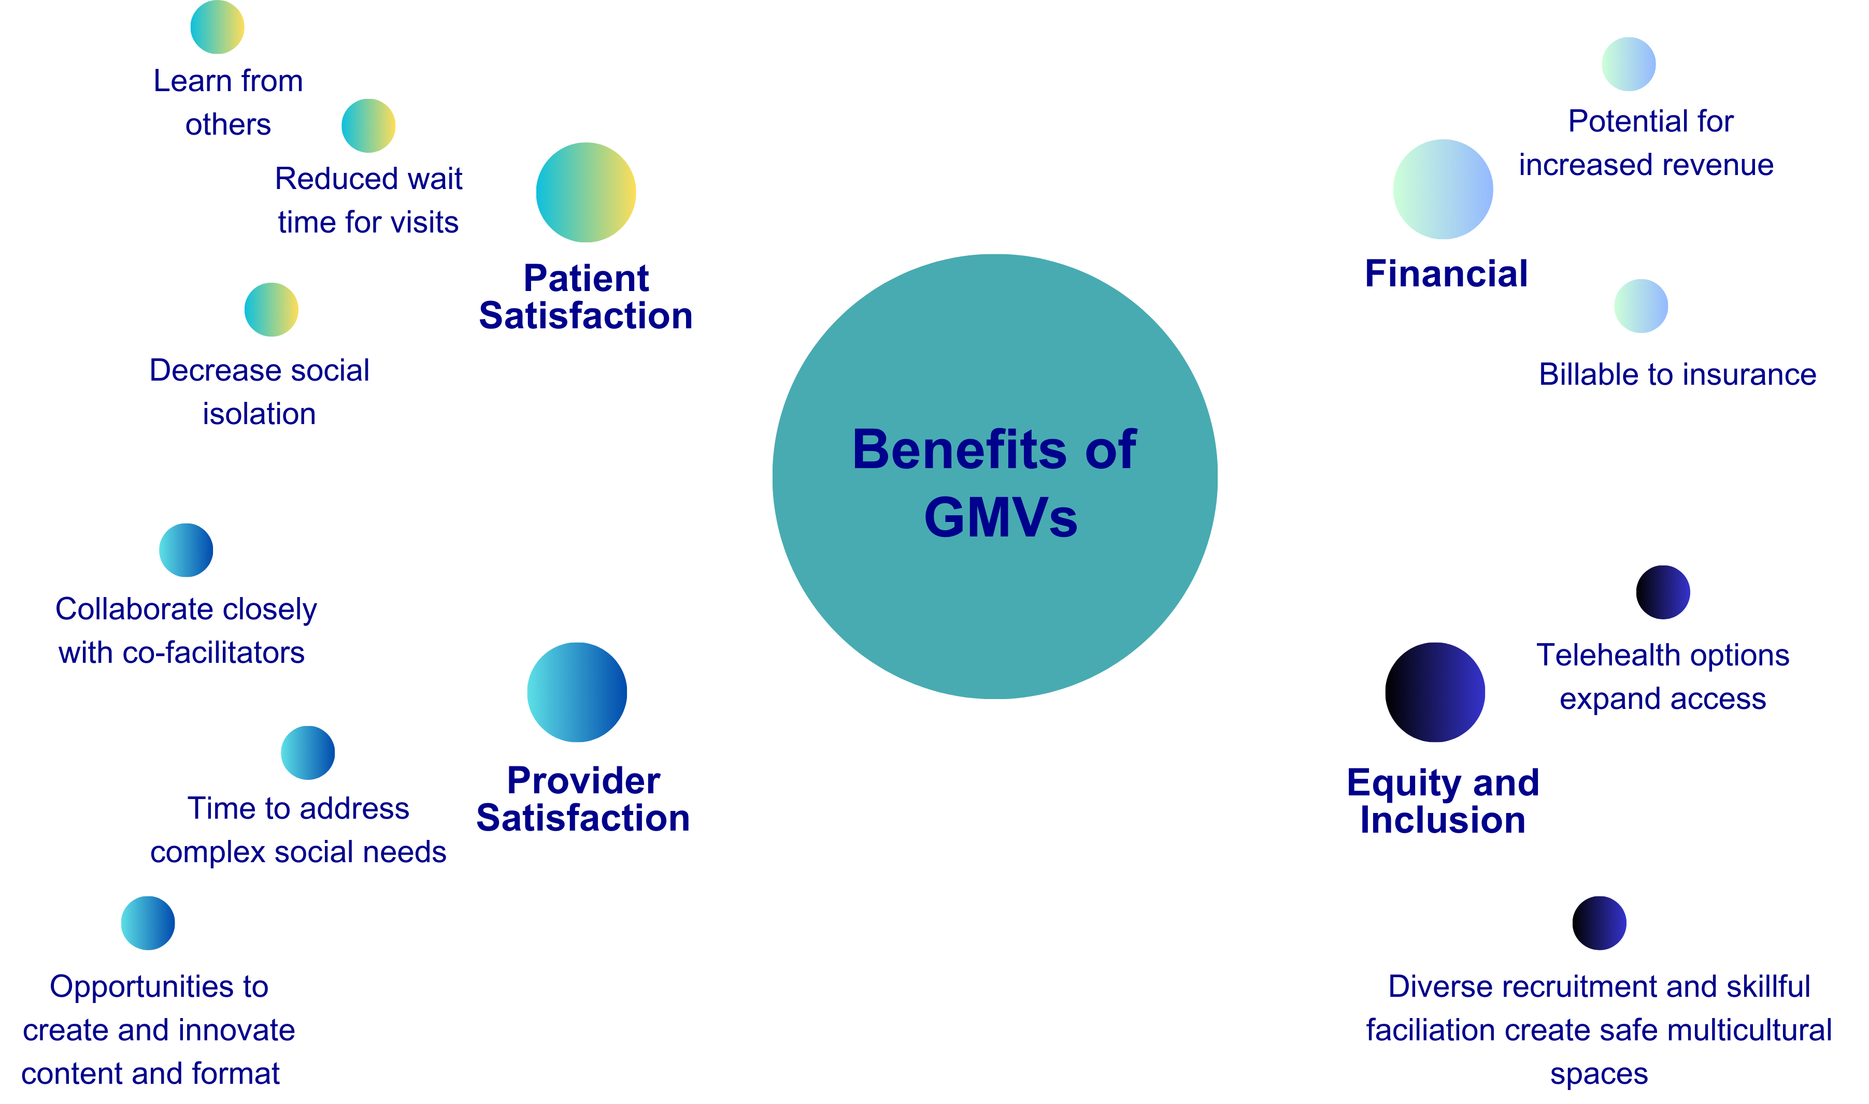
Group Medical Visits: Growing nationally at Osher Centers
Notes:
GMV = billable appointments during which multiple patients with similar concerns meet with clinicians simultaneously
Plenty of evidence supporting GMVs
This talk will focus the specifics of GMV implementation and the clinical operations work that they require

Slide 6

GMV: Overall Themes
Experiential / Practical
“balance between data and actual time spent on learning”
“constructive choices and changes without being overwhelming.”
Empowerment
“resources we need to adapt and make positive changes.”
“Discovery of what I ‘can’ do”
Diversity of patients & practices
“diverse group but have much in common beyond our diagnosis.”
“Eastern and Western medicine”
“different ways of meditating"
Community Group wisdom
“connection…more receptive to trying, growing and learning…”
“I found solace in the idea that my experience is both entirely unique and somewhat predictable…"
Notes:
Kavita
Along with the quantitative analysis we wanted to understand the qualitative aspects of our pilot and how to best acknowledge, characterize, and adapt with the feedback we were receiving from patients, team members, fellows and our own reflections.
There were four major themes that arose in our analysis.
1. Empowerment – that with knowledge, practice, and wisdoms such as acceptance, self-compassion patients could feel empowered towards pro-health behavior. And picking up a few examples of quotes from patients:
”(The Doctor's have organized a concise and dynamic way to present the) resources we need to adapt and make positive changes during our cancer treatment and beyond.”
“Discovery of what I ‘can’ do, like chair yoga.... I feel that I have been limiting myself in my power to exercise.”
2. Being Experiential and Practical was critical – that even simple practices, repeated could be transformative
“I really liked the balance between data and actual time spent on learning the breathing exercises and meditation and creative visualization through art…”
“…enough information to make constructive choices and changes without being overwhelming.”
3. Community and the concept of group wisdom; that there is the acknowledgement of the unique human experience and there is a common human experience, and connection; that this could be a safe space and we could discuss common challenges – time, distractions; racing thoughts, side effects of rx.
“The group format added a level of connection that makes us more receptive to trying new exercises, and growing and learning.”
“I found solace in the idea that my experience is both entirely unique and somewhat predictable. ((Hearing from others who are also experiencing the anxiety and stress of cancer, but from different backgrounds, and with different approaches to mindfulness was helpful and interesting.))"
4. Diversity: Different tools can work for different people at different times
“We are a diverse group but have much in common beyond our diagnosis.”
“informative balance between Eastern and Western medicine”
“…when I sit down to meditate, I would doze off. So it’s nice to learn different ways of meditating. I try to focus on my breathing while I walk. I was practicing qigong”
Want to focus in further on empowerment and diversity

Slide 7
OCIH at UC San Francisco
Kavita K. Mishra, MD, MPH
Gabriela Gutierrez, BS

Slide 8
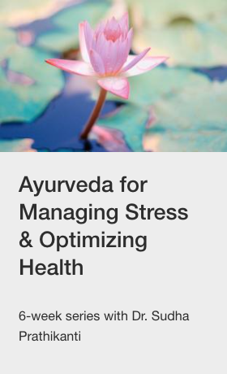


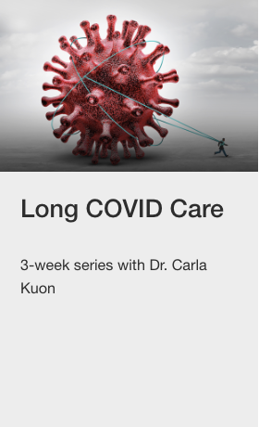

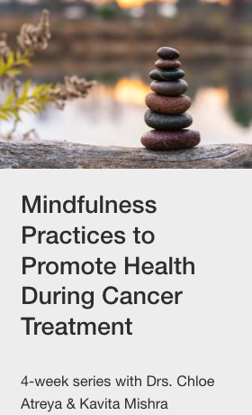
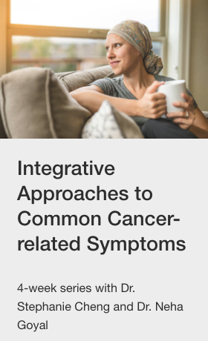
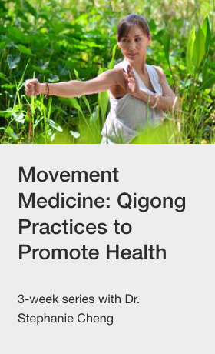
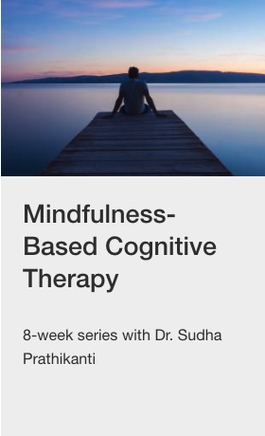

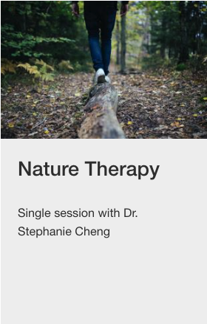



OCIH/Cancer Group Medical Visits
UCSF Osher
UCSF Cancer Center

Slide 9
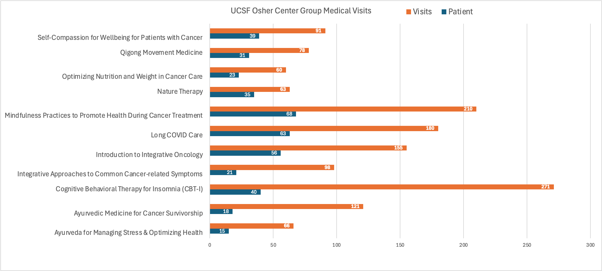
Total #Patient Visits and Unique Pts FY24

Slide 10
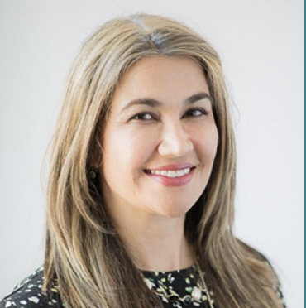
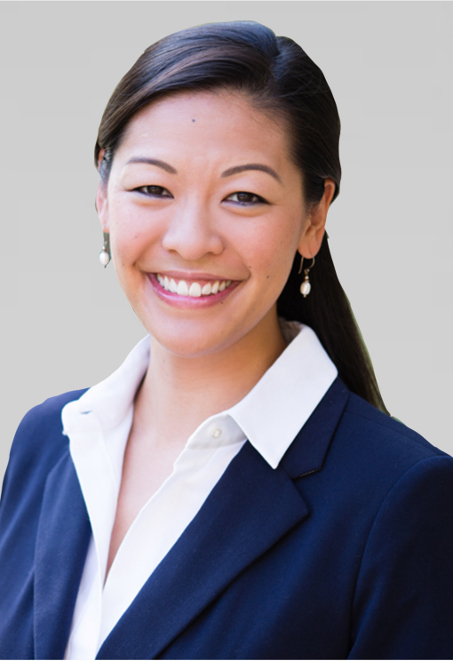
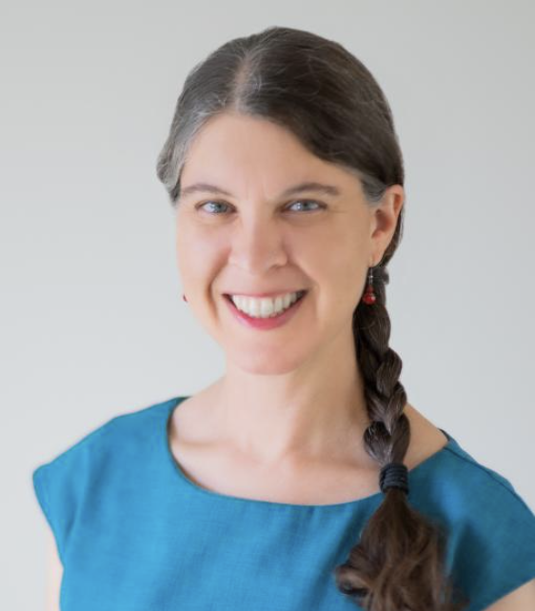
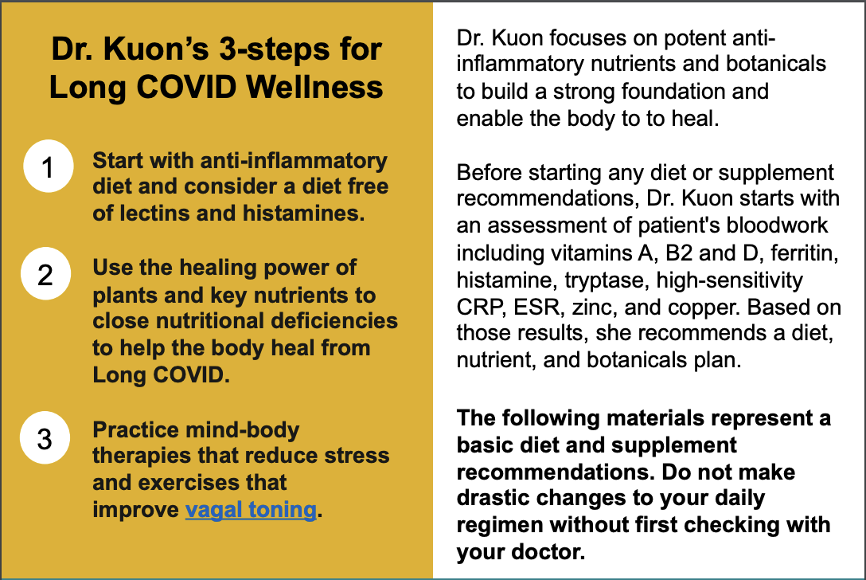
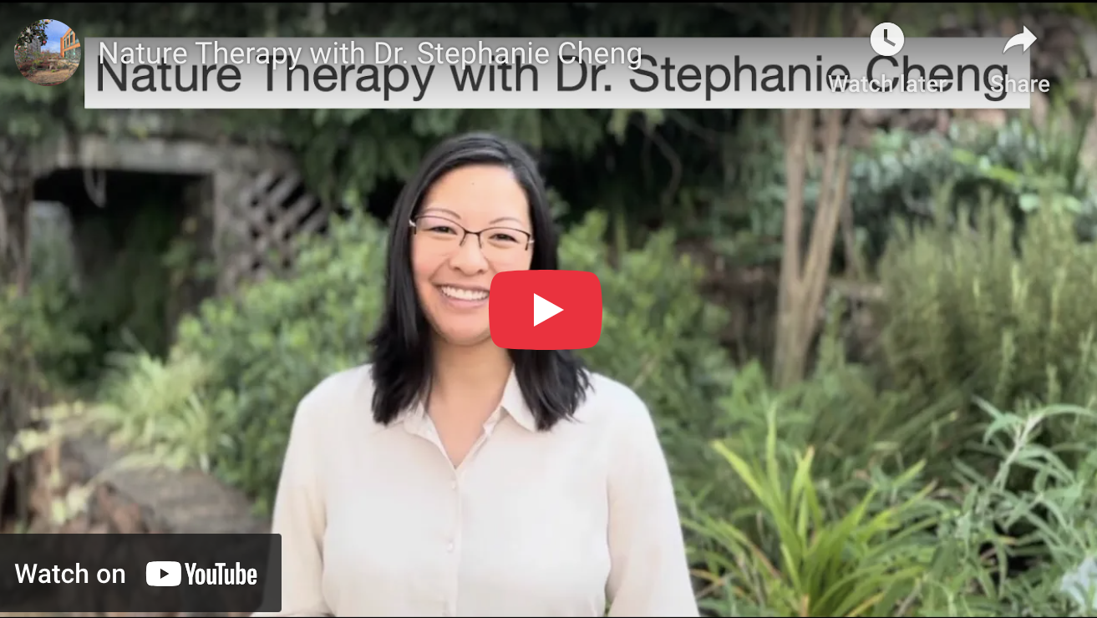
Examples: Access, Innovation, Satisfaction
Long Covid
Mindfulness-Based Practices in Cancer Treatment
Nature Therapy
3-weeks
Lab data
Nutrition and supplement interventions
Access to long covid care
Single session
A green space of your choice/ability
Certified nature and forest therapy guide (shinrin-yoku)
“Groupies”
An accessible, immediate stress-reduction tool
4-weeks
50% reserved for BIPOC patients
Practices from diverse origins
Places mindfulness within patients’ own spiritual life
Trauma-informed language
Equity-informed agreements*
High patient/provider satisfaction scores
* East Bay Meditation Center

Slide 11
Analysis: GMV Operations
Analysis
Prioritization
Implementation
  Context: UCSF MD student on a Predoctoral fellowship at OCIH
    Needs assessment
    All GMV providers/series
    Guest-participant in every session of every GMV offered for 3 months
    Priority areas for series & session quality improvement
    Priority areas for GMV-wide process improvements
  Executing on high priority needs:
    Staff Workflow
    Referral Process
    Patient Materials
    Research-QI

Slide 12
Priority Areas for Operational Workflow
Session 1,2,3,etc.
Wrap-Up and Prep
Referrals
Scheduling
Onboarding
Recruitment – flyers, newsletters, clinician and patient comms
Updating the website
Publishing FAQs
Referrals triage
Wait lists generation
Insurance info and auth process; billing guidelines
Scheduling details for each group
Consent forms
Content creation &
Materials
Instructions and to-do lists
Staff checklists
Intake surveys
Telehealth and in-person support
Staff workflow refinement
Real-time adaptations (content,
group needs)
AVS
Post Surveys
Materials for next session
Answering questions

Slide 13


Flyers

Slide 14
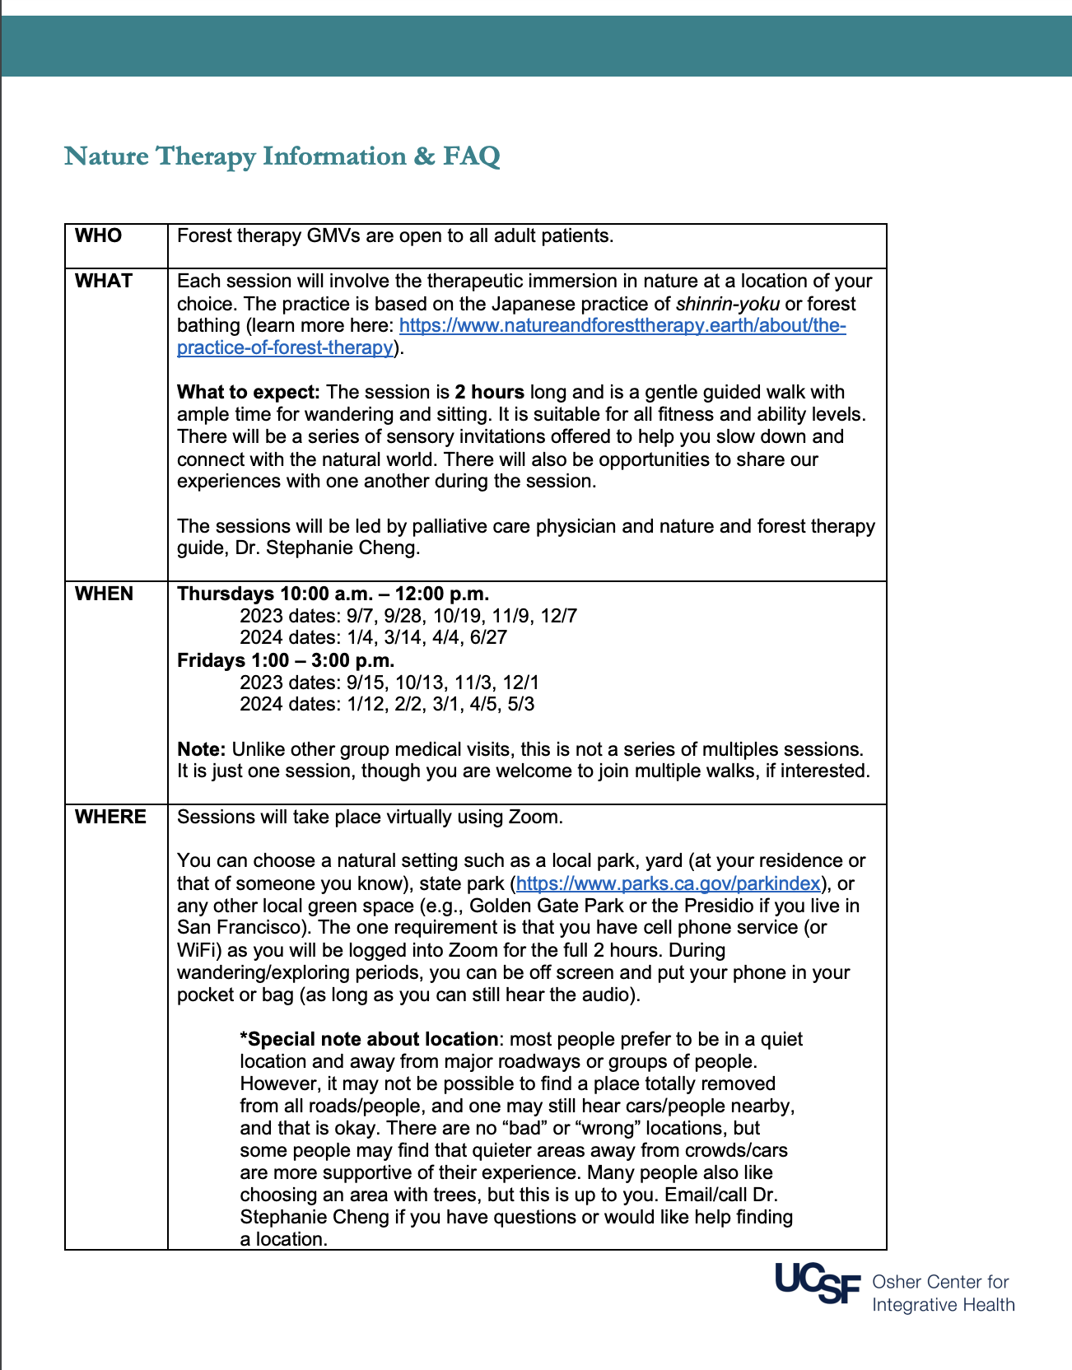
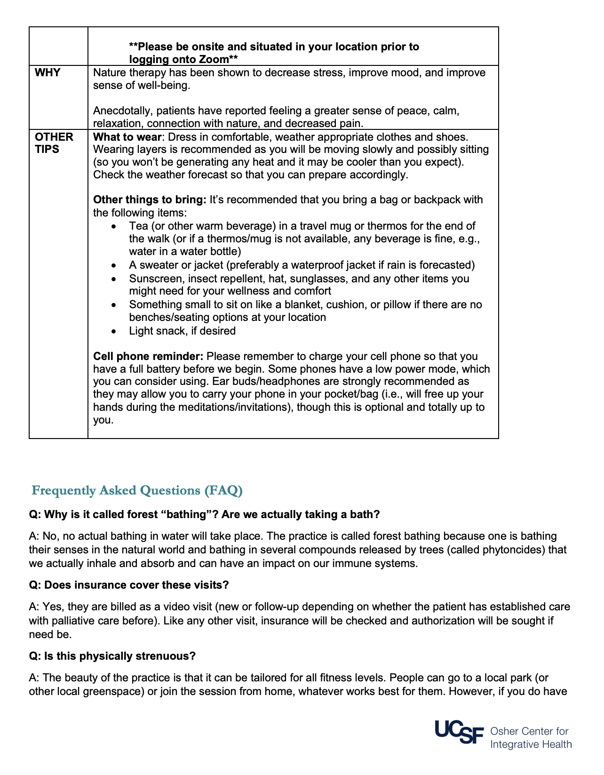
FAQs

Slide 15

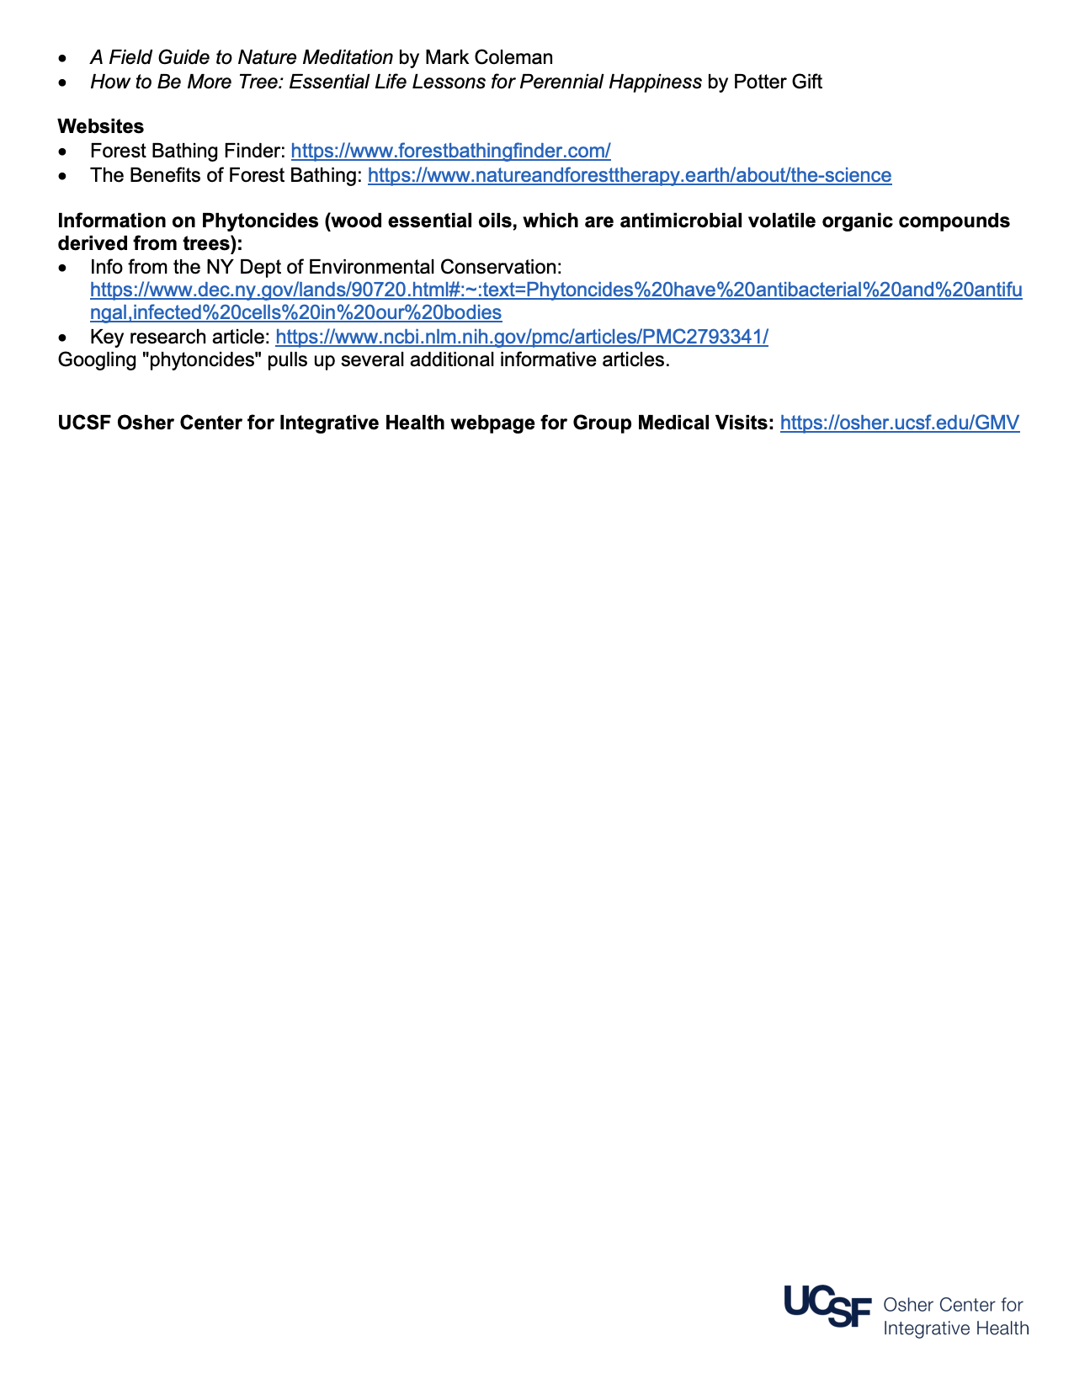

Slide 16
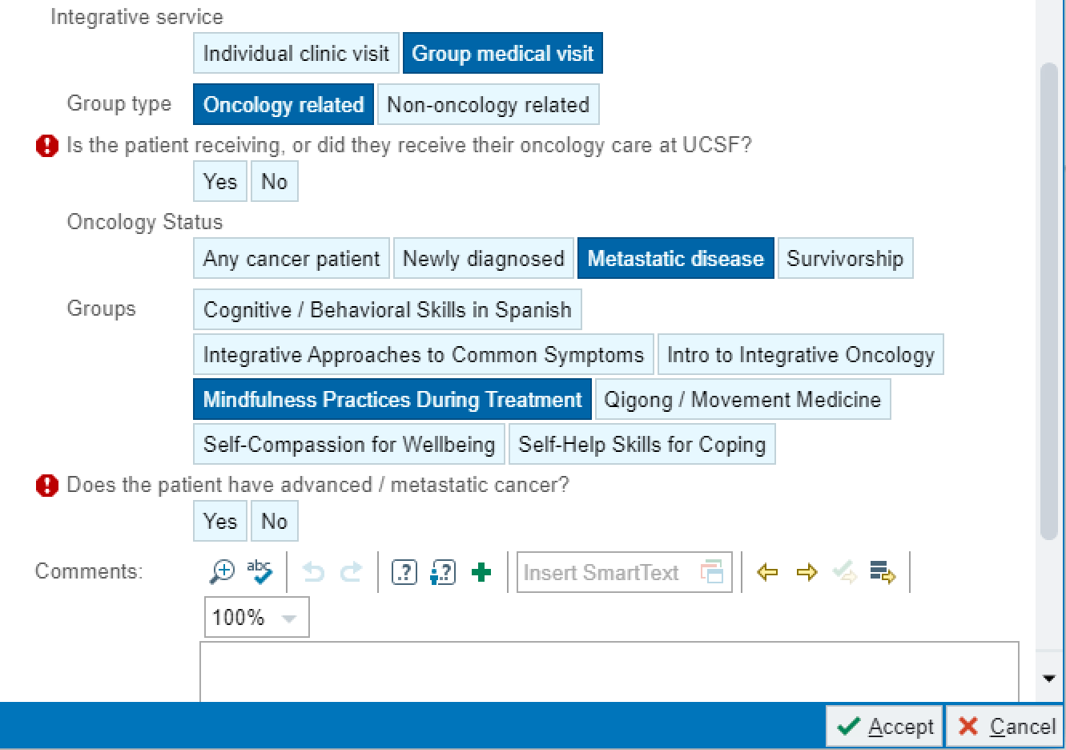
Referral Process Simplified

Slide 17
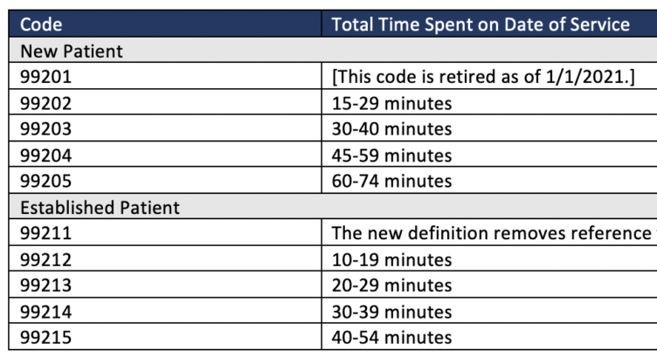
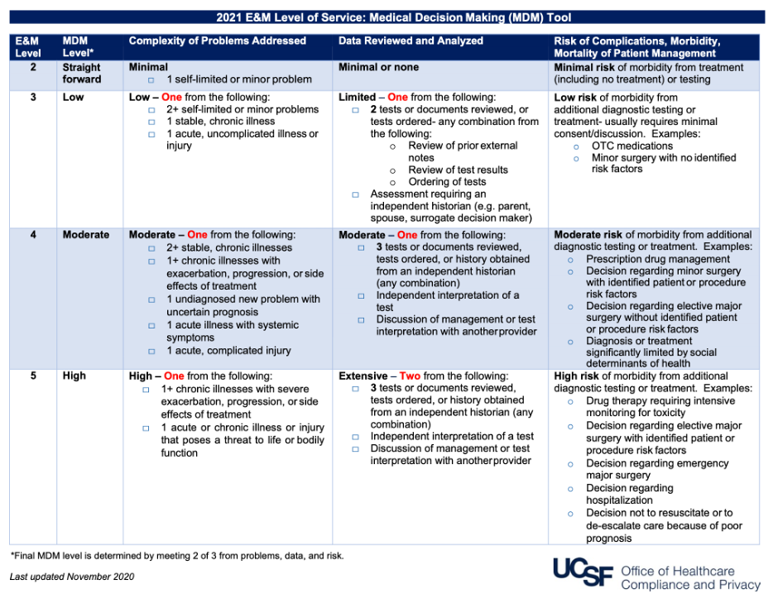
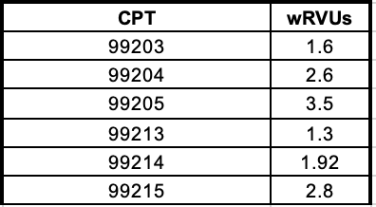
Billing & Compliance
Additional Codes:
90853 Psychotherapy 0.65
96164/96165 Health behavior (0.23, 0.11)
Resources: Compliance & ICGMV.org

Slide 18
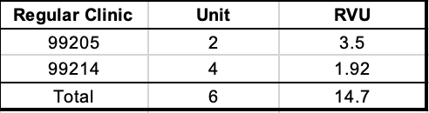
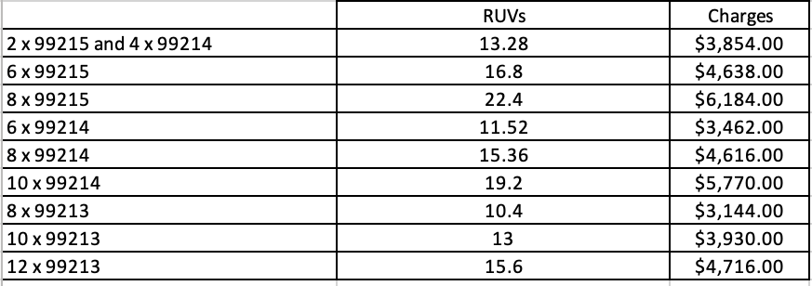
NP v FU & Coding level
CPT/# of pts | 6 | 8 | 10
99213 |  | 10.4 | 13
99214 | 11.5 | 15.4 | 19.2
99215 | 16.8 | 22.4 | 28

Slide 19
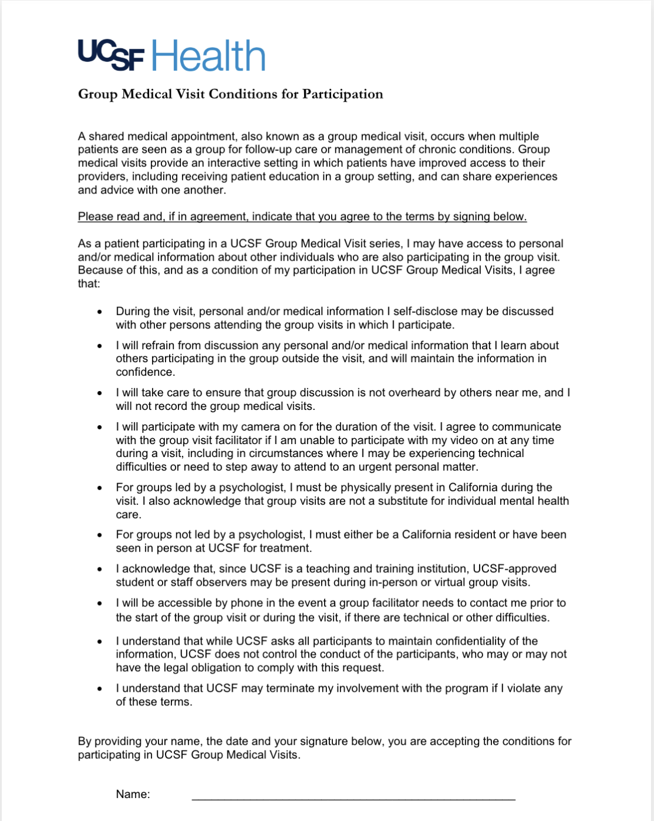


Consent Form and Slides

Slide 20
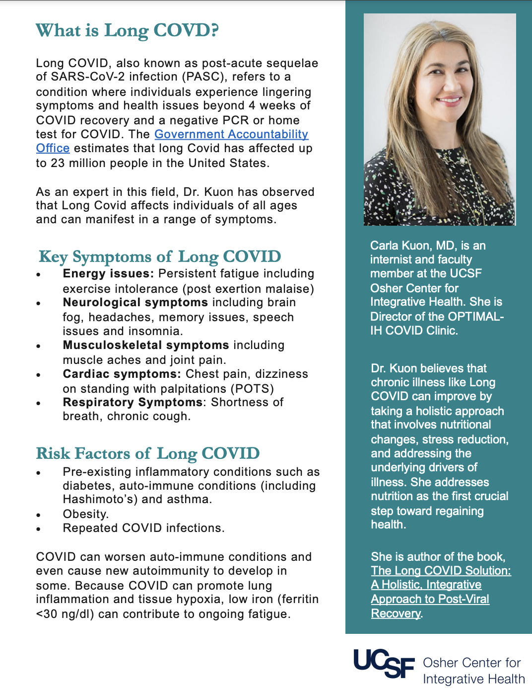
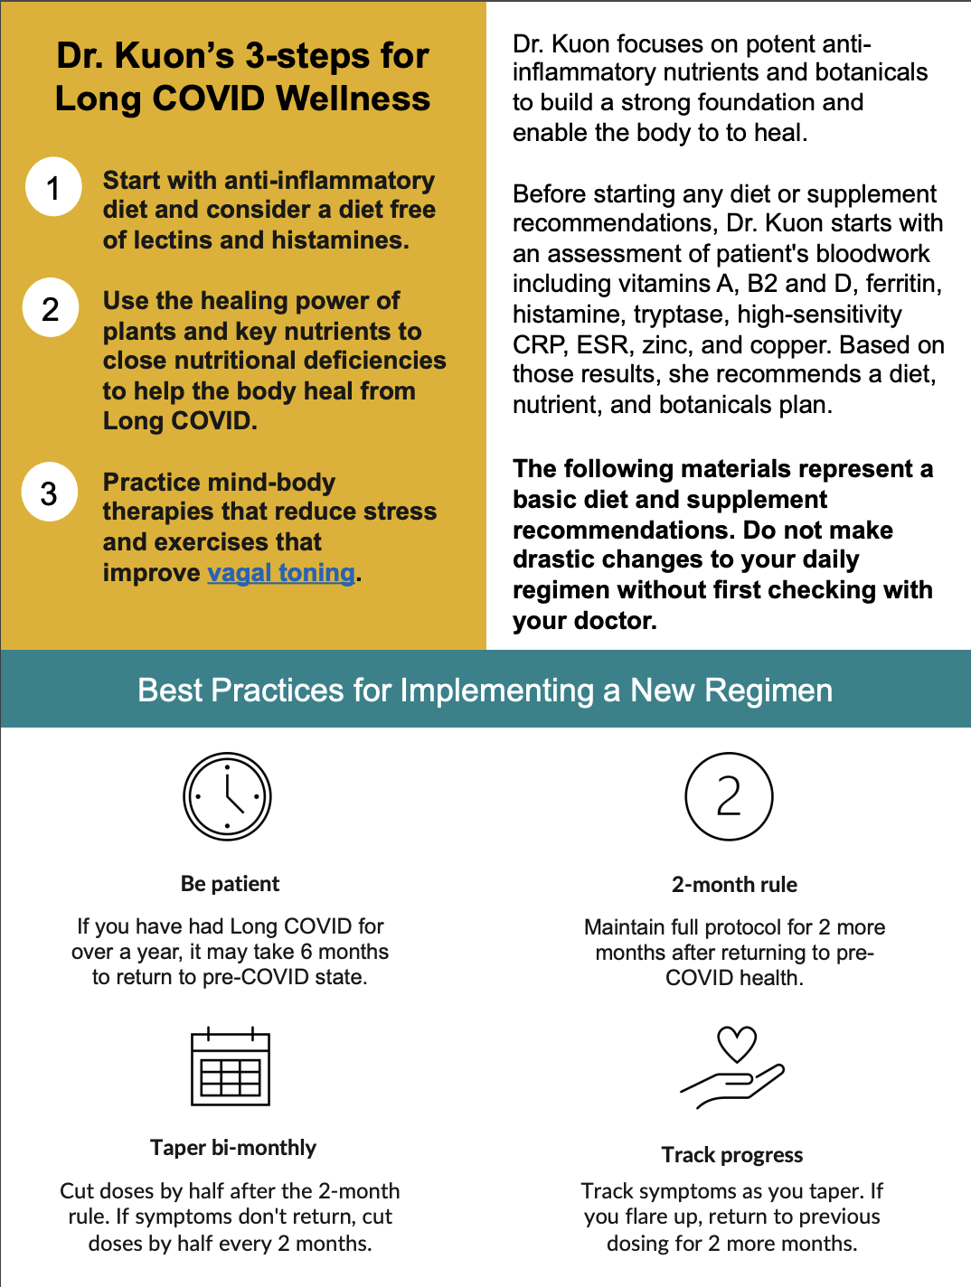
GMV Content for Patients

Slide 21
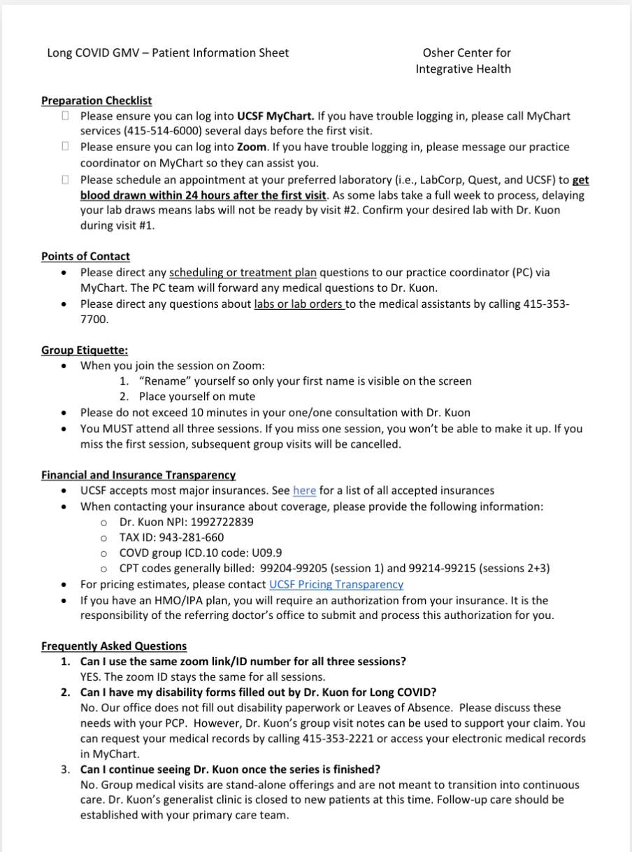
Patient
Onboarding
Instructions

Slide 22
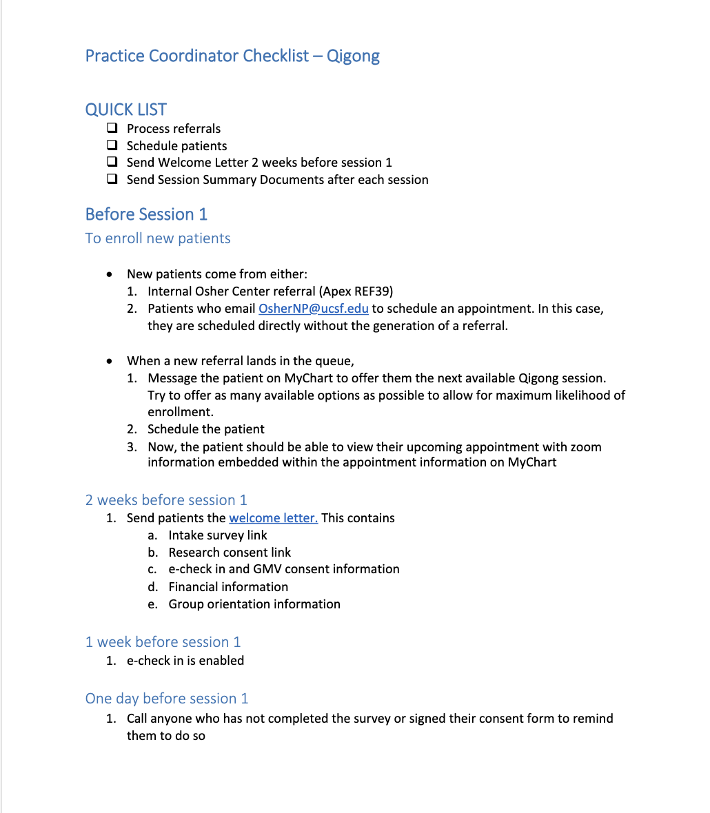
Staff
Workflow

Slide 23
GMV Operations: Key Pearls
    EHR Smart Referral work
    Simplifying Patient Communications
      Access for cognitively-impaired people or people with poor tech literacy
      Designing "intake bundles" to simply pre-group instructions
    Staff/Coordinator checklists
      Attending the first 15 minutes of GMVs for support
      Tech/Logistics: Breakout room structure; chat support
    Consistency of Group materials
      Patient surveys, consent forms, pt information, FAQs
    EHR automation for patient communications: consent forms in EPIC
    Compliance work for billing, notes
    Future AI scribe assistance

Slide 24
OCIH Madison – Wisconsin
Greta Kuphal, MD

Slide 25




Slide 26


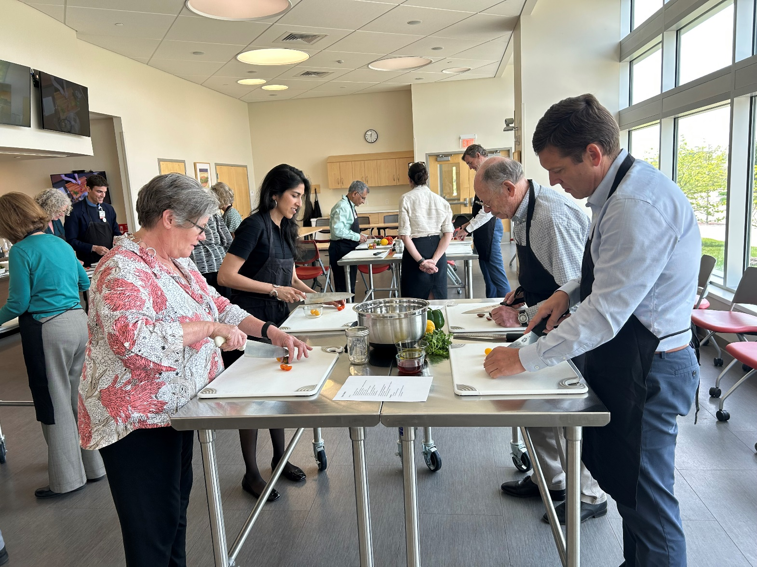
Our Offerings
Current GMVs (number of sessions)
Getting to the Heart of a Health Life (6)
Goodbye Nicotine (6)
Healing Chronic Pain (6)
Kitchen Wisdom (4)
Living Well with Atrial Fibrillation (6)
Mindful EcoWellness: Steps to Healthier Living (7)
Mindfulness for Your Health (4 or 6)
Whole Health for Kids: Mind, Movement, and Me (4)
Yoga 4 Cancer (6)
Previous GMVs
Healing Waters
Stress Reduction and Resiliency
Healthy Sleep
Healthy Aging

Slide 27
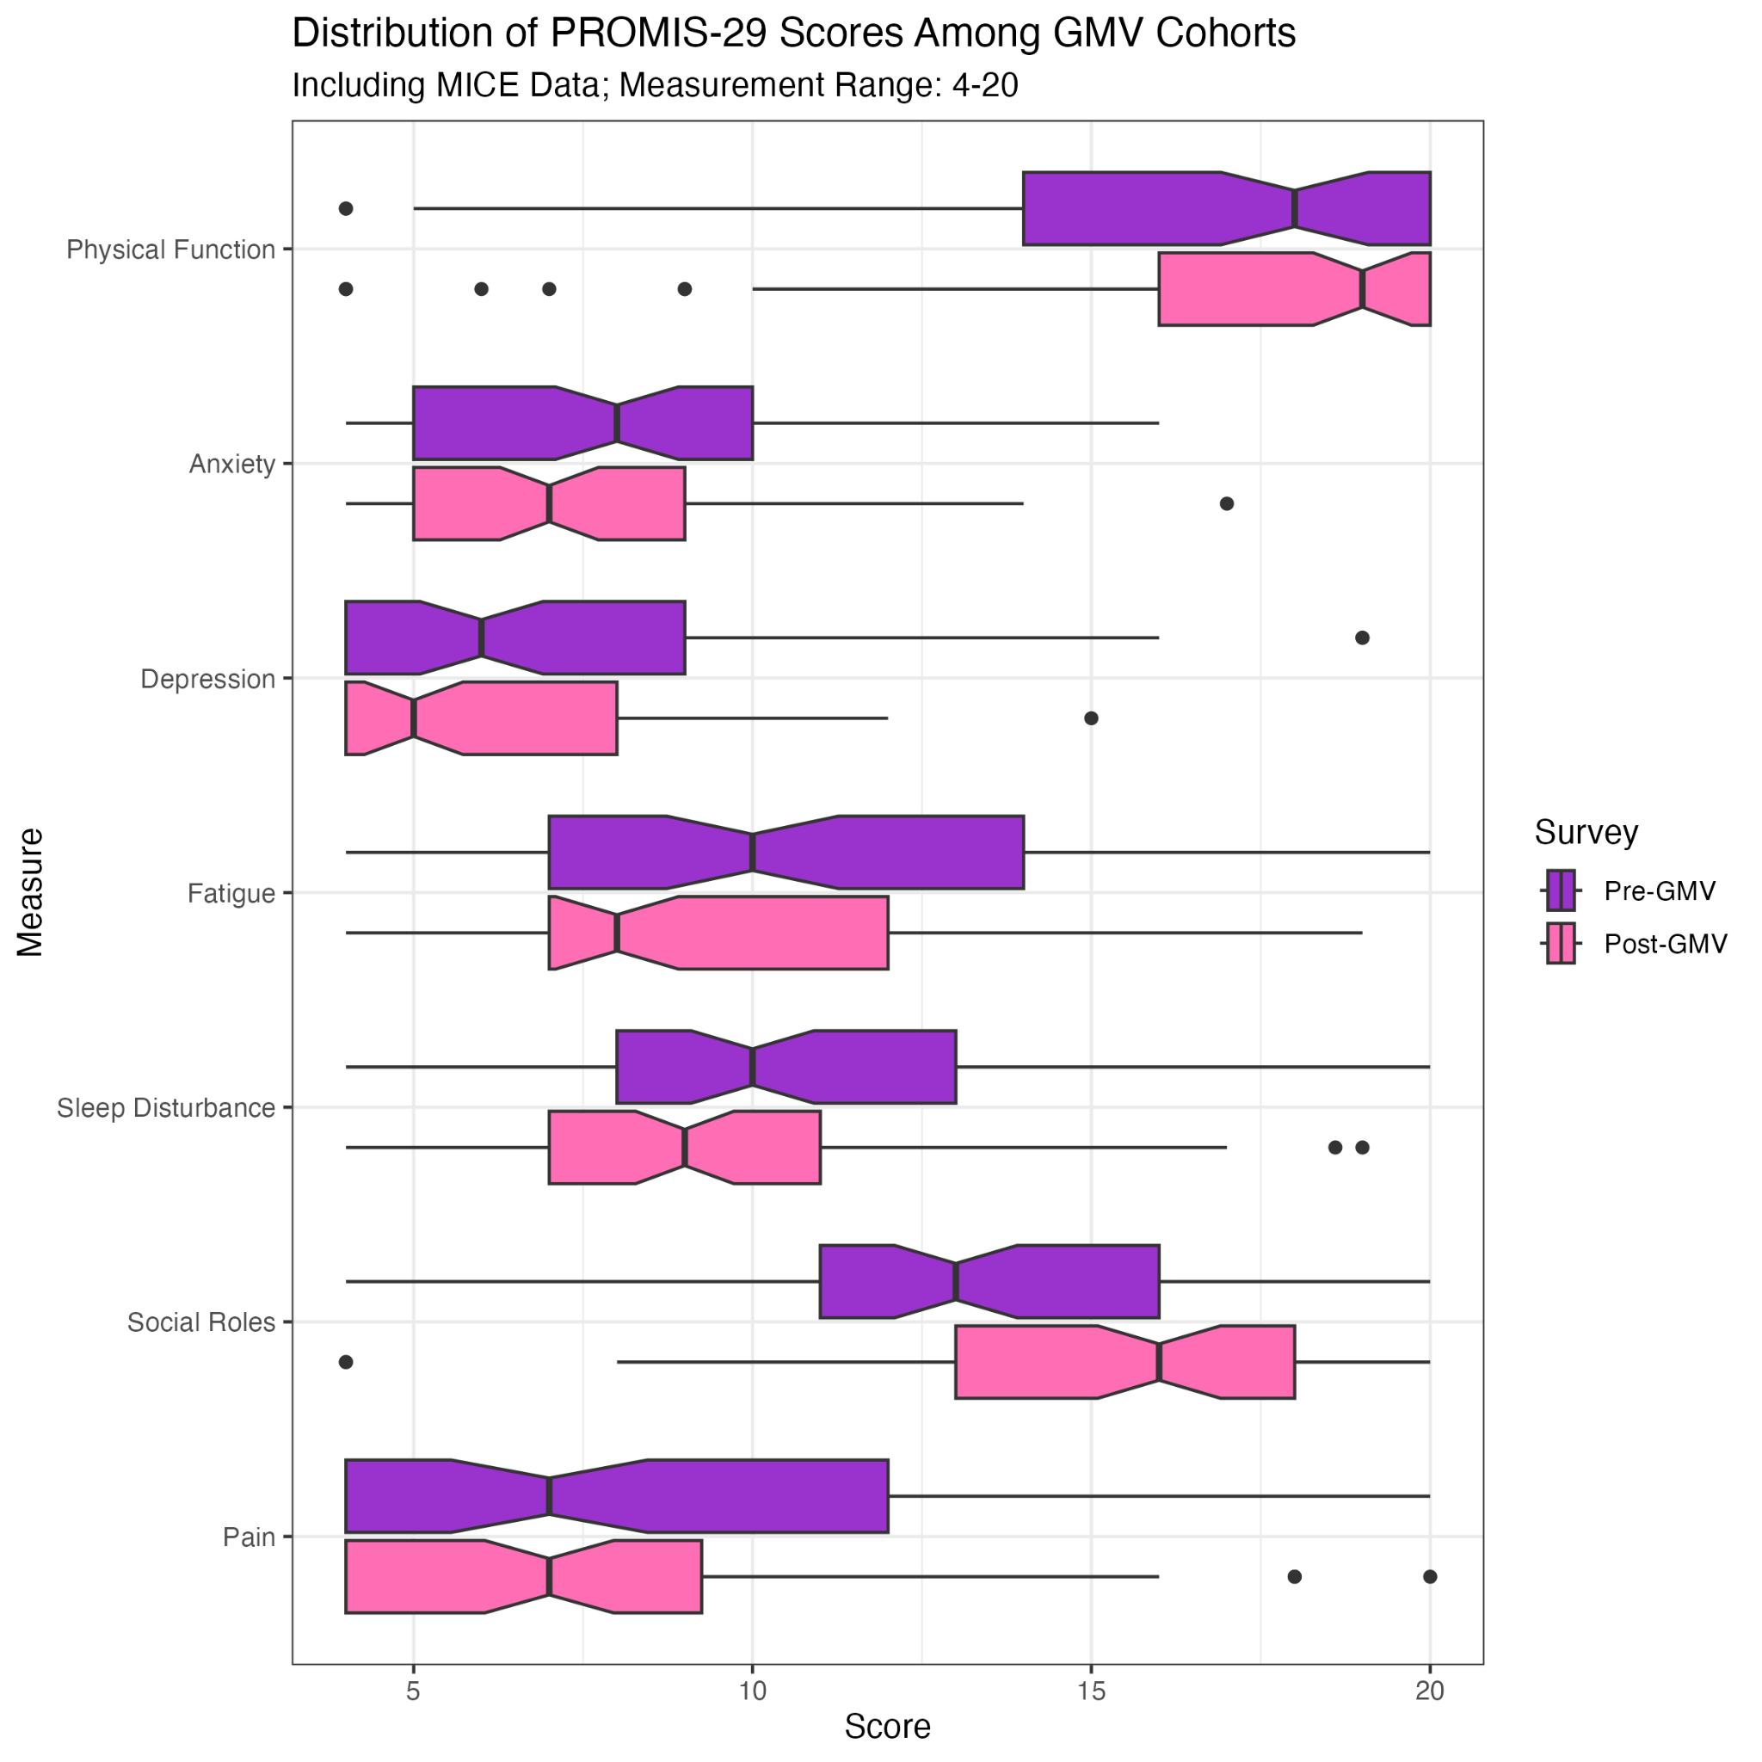

Outcomes
Data
Distribution of PROMIS-29 health domains median scores. Data is from 16 cohorts from 2017 to 2024, n = 68

Slide 28

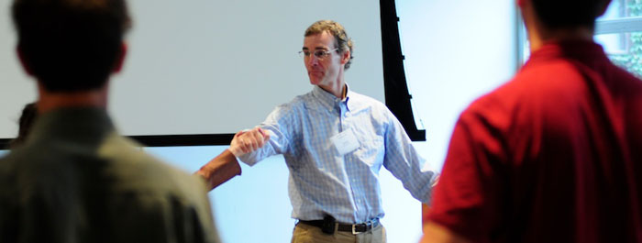

Dedicated Support
GMV Clinician Lead (currently a physician assistant) and Integrative Health registered nurse as a dyad
  Support new providers in designing and planning GMVs***
    We’ve intentionally made this a health system wide resource
  Clinician lead gets 0.1 FTE (Previously funded through Osher Center, health system has taken over)
  RN is full time but splits GMV coordination with other IH clinical duties
01

Slide 29
Outline roles and responsibilities of clinician and operational support staff
Content of GMV
  Development of a curriculum
  First session housekeeping (orientation to format and space, community agreements, introductions, consent form, pre-GMV evaluation)
  Balance of didactic, sharing/reflection, experiential learning
Infrastructure
  Referrals and recruitment
    Newsletters, division meetings, weekly clinical communications
    EHR “dot phrase”
    Consult order
  Pool of health coaches, exercise physiologists, mindfulness instructors, chef, dieticians to help co-facilitate
Development of a
Playbook

Slide 30

Compensation for clinician based on their home department
  Most get a salary with AAMC benchmark rate
  We aim for minimum of 6 patients per group to cover this
Co-Facilitators
  GMVs are largely held at hospital-based facilities which charge a facilities fee. This is the source of funding for contracted providers.
Coding and Billing
  Meeting with compliance and ongoing auditing of billing; documentation support with standardized note templates
Patients are counseled to check with insurance coverage—most might expect to have a co-pay every session
Financials

Slide 31
PROMIS-29
Post GMV provider survey looking at clinician perspective on quality of patient interactions, impact on patient wellness, personal fulfillment/joy of practice
Pre GMV patient survey assesses how they heard about it, their own goals, baseline self-rating of physical and emotional health, basic demographics
Post GMV survey assesses self-rating of physical and emotional health; impact of GMV on health and confidence of self care, understanding of what matters most and quality of life; evaluation of facilitators
Looking forward to release of the Personal Whole Health Index!
Evaluation

Slide 32
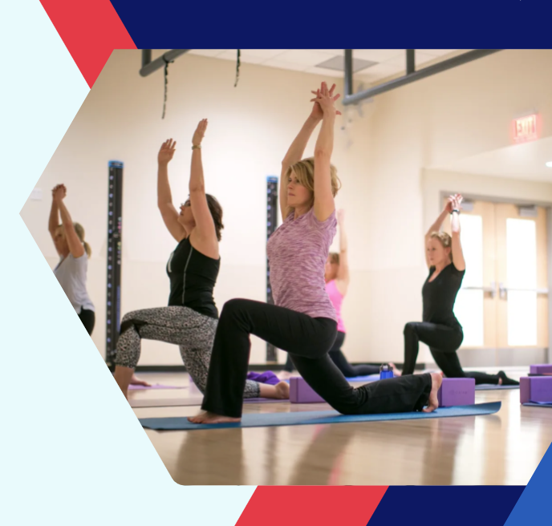
Patient autonomy and empowerment
Sense of community
Patient satisfaction
Appreciation for integrative care
Trust
Common themes from clinician and patient interviews

Slide 33
OCIH Vanderbilt
Gurjeet Birdee, MD
Katy Hansen, PhD

Slide 34
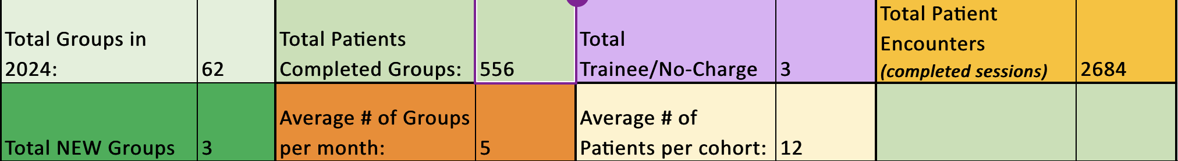
Vanderbilt IMGV Snapshot: Billable group visits
Billable groups are led by Nurse Practitioners, Physician, Psychologists
We currently offer 13 different integrative medical and psych group visits
  Condition specific (Chronic pain, Hypermobility Syndrome)
  Mindfulness (Mindful Self Compassion, Mindfulness Based Cognitive Therapy, Mindfulness Skills)
  Hypnosis (for Stress, for Chronic Pain)
  Culinary Medicine (Anti-inflammatory cooking)
Notes:
Held to palliative care session metrics:
For APRNs:
Threshold 4
Target 4.22
Reach 4.52
Schedule 22 for average attendance of 12/visit

Slide 35
Group Format
Telehealth: Over 90% of groups are offered via telehealth at Vanderbilt
  Some clinicians licensed multiple states to expand access (primarily Kentucky)
  Pros and cons of telehealth
In-person: Basics of Breathing, Yoga
Hybrid: Taichi- Skill set for tracking and supporting in-person and online participants
Dosage of Care
  Single-session groups
  4-8 week groups

Slide 36
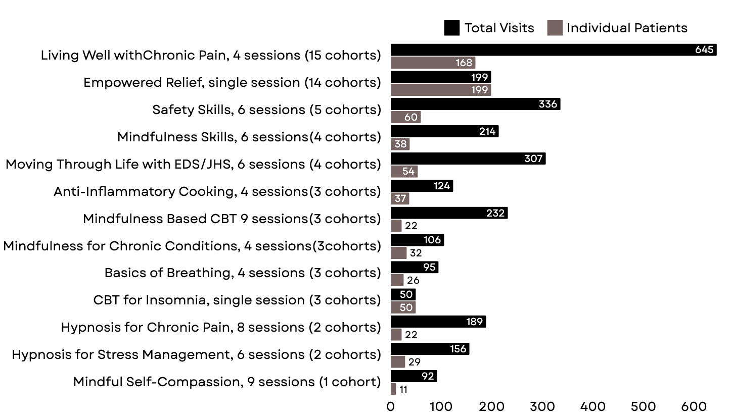
Snapshot: 2024 Integrative Medical Group Visits at Vanderbilt

Slide 37
Building a Cohesive Program
Professional Development for Group Facilitators
  Quarterly Group Facilitator Meetings
    Review group evaluation feedback
    Best practices for group facilitation skills
  Refining group processes- One additional hour of admin time blocked for group visits
  Cross training facilitators so more than one clinician can deliver each medical group
  Inter-professional cross training- some groups can be led by nurse practitioner or a psychologist- allows for wider patient access due to different billing capacities of different roles
Notes:
Gurje

Slide 38
Administrative Support
  Program Manager 50% effort dedicated to supporting group visits (medical, psych, yoga, Taichi)
  Evolution of program manager role over time-
    clinical screening role (RN)
    marketing role (business administrator)
    team effort (all admin schedules)
    Current: Program Manager, cost covered by clinic budget
Notes:
Gurjeet- add group pro forma?
Talking points: evolution of program manager role over time- has varied over the years from a clinical screening role (RN), marketing role (business administrator), team effort (all admin schedules) into the current program manager role- cost covered by clinic budget
-We don’t have a medical assistant, we do have a group program manager

Slide 39
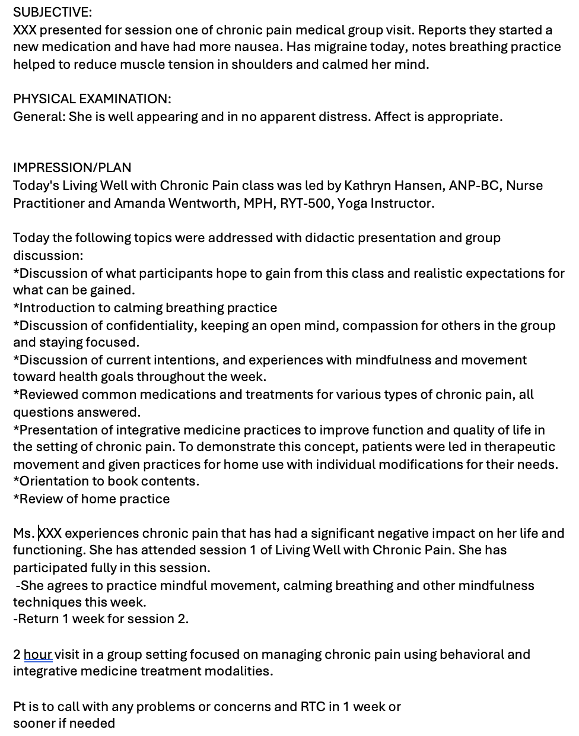
Documentation
Subjective: Document individual check in and anything that may come up in course of visit discussion.
Objective:
Vitals
Physical exam
Impression/Plan:
Condition addressed
Overview of what happened in the visit
Any individual plan details (homework, etc)

Slide 40
Billing and Cost Variables
  -NPs and MD mostly bill 99213, unless additional 1:1 time took place or changes to medication or treatment plan were completed
  -Medical group visits represent between 9% and 46% of annual visits for our 1 MD and 3 NPs
  -Psychologists bill for HBAI codes, 1st 30 min plus add on code in 15-min increments
  -Cost variables: cost of non billing co-facilitator, supplies (culinary medicine), in-person facilities fees, front desk support for in-person check-in

Slide 41
Cost estimations
Group parameters: Size and duration and attrition
Income and expenses
  Charges and collections
  Provider, support staff, and admin (salary & fringe)
  Telehealth and In-person

Slide 42
Example of margins based on different groups
Provider | NP | MD | NP
Duration (weeks) | 4 | 4 | 1
Class length (hours) | 1.5 | 1.5 | 2
Total # participants | 51 | 51 | 18
Revenue | 5644 | 6458 | 1984
Expense | 1764 | 3096 | 441
Profit/(Loss) | 3880 | 3362 | 1543

Slide 43
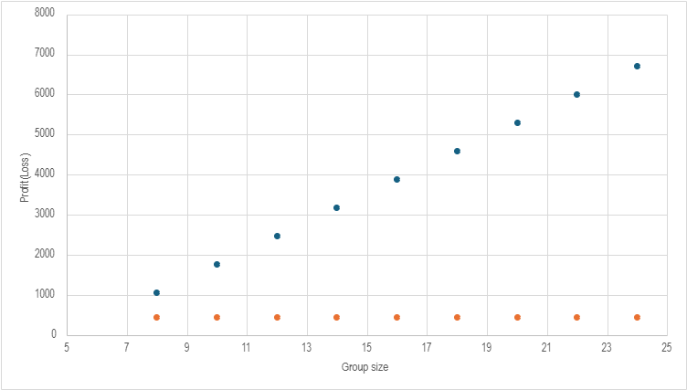
Margin as function of varying class size
NP-led GMV 1.5hr
NP clinic-6 return visits

Slide 44
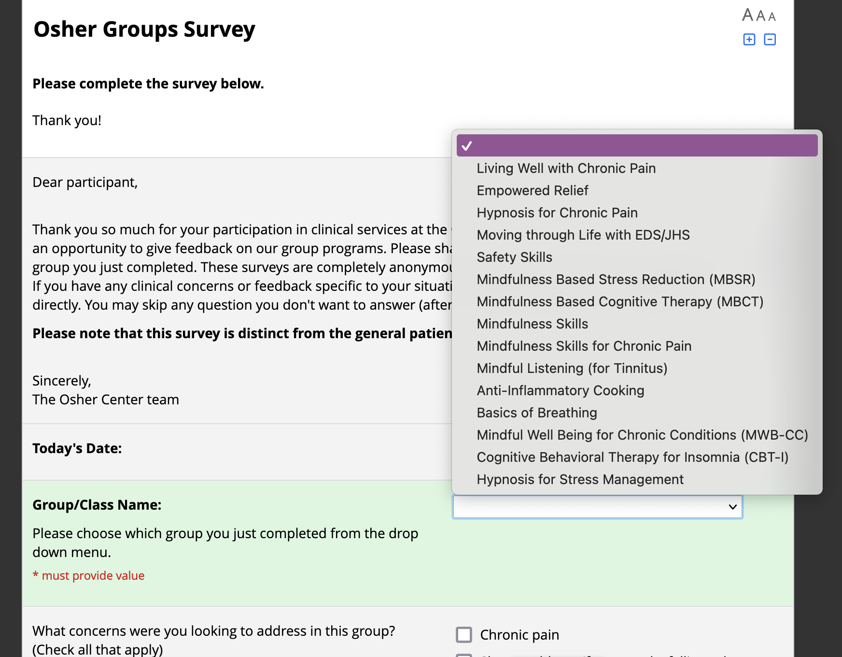
Survey is anonymous
30 items
Likert and free text
Survey is anonymous
30 items
Likert and free text

Slide 45
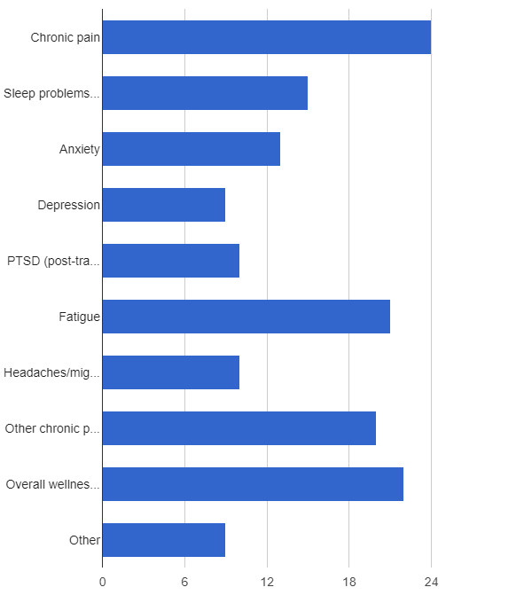
Group experience survey results
What concerns are you looking to address?
(Check all that apply)
Notes:
ADD N/5 FOR CONDITIONS

Slide 46
Group experience survey results
ITEM | MEAN
I learned information in this group that is relevant to managing my health. | 4.81
I learned skills and tools in this group that have helped me manage my health. | 4.62
I felt supported by the group facilitator(s). | 4.85
I felt supported by other members of the group. | 4.80
How useful did you find the class materials? | 4.42
How likely are you to recommend this group to others? | 4.80
0 to 5 scales
Strongly disagree (0) to strongly agree (5)

Slide 47
Group feedback: What did you find most helpful?
  Connecting with others who understand my limitations.
  Connecting with others like me. Learning about fascia and central sensitization.
  Loved getting to interact with others w/ eds. getting to learn how others navigate life, and what can help. really liked learning about the more medical side of it too - ex fascia, central sensitivity
  Facilitator encouraging us to be physically comfortable during the appointment. Being able to take the class from bed made this doable for me. and now I'm more willing to ask for similar accommodations in other appointments.
  Community in minority. Fascia facts. Dynamic disability and pacing. Advocating and making accommodations for yourself.

Slide 48
Suggestions for improvement and adjustments
Group should be longer
  Adjusted from 5 to 6 sessions
More focus on practices for coping with pain
  Include practice of coping skills in each session (e.g. guided visualization, somatic tracking, body scan)
Ongoing support
  Invitation to members to exchange contact info as desired
Future/needed
  Resources for further study
  Information about scientific literacy

Slide 49
Vanderbilt: Key Takeaways
  Improved access to care, particularly for those who live at a distance or whose health makes it difficult for them to travel
  Nurturing group facilitation professional identity
  Program Manager role as part of clinical services has allowed us to grow and support our group visit programs
  Patient feedback and evaluation essential to ongoing quality improvement

Slide 50
Operational Science & Financial Models for Group Medical Visits
Implementing Practical and Sustainable Delivery Paradigms in Integrative Health
Kavita K. Mishra, MD, MPH UCSF Osher
Gabriela Gutierrez, BS UCSF Osher
Greta Kuphal, MD U Wisconsin Osher
Gurjeet Birdee, MD, MPH Vanderbilt Osher
Katy Hansen, PhD Vanderbilt Osher

Slide 51
Q&A
Thank you!

